Slide 1
CHAT CONNECT- A REAL-TIME CHAT AND COMMUNICATION APP

Slide 2
PROJECT OBJECTIVES
ChatConnect is a sample project built using the Android Compose Ul toolkit.It demonstrates how to create a simple chat app using the Compose libraries. The app allows users to send and receive text messages. The project showcases the use of Compose's declarative Ul and state management capabilities. It also includes examples of how to handle input and navigation using composable functions and how to use data from a firebase to populate the UI.
FUNCTIONS
User authentication : secure login.
Real-time messaging : text chat with instant delivery. Media sharing : users can share images , videos and files. Push notifications : notifications for new messages.
Typing indicators & Read receipts : to show when users are typing or when a message is read.
Group chats : ability to chat in groups with multiple users.

Slide 3
MAIN ACTIVITY.kt :
package com.vivek.chatingapp.repository
import com.google.android.gms.tasks.OnCompleteListener import com.google.firebase.firestore.*
import com.google.firebase.firestore.EventListener import com.google.firebase.messaging.FirebaseMessaging import com.google.gson.JsonObject
import com.vivek.chatingapp.model.MessageBody import com.vivek.chatingapp.network.Api import com.vivek.chatingapp.utils.Constant import com.vivek.chatingapp.utils.Resource
import kotlinx.coroutines.tasks.await import okhttp3.ResponseBody import org.json.JSONObject
import retrofit2.Response import java.util.*
import javax.inject.Inject import kotlin.collections.HashMap

Slide 4
class MainRepository @Inject constructor( private val fireStore: FirebaseFirestore,
private val fireMessage: FirebaseMessaging, private val fcmApi:Api,
private val remoteHeader:HashMap<String,String>
) {
suspend fun updateToken(token: String, userId: String): Boolean {
return try {
val documentReference = fireStore.collection(Constant.KEY_COLLECTION_USERS).document(userId) documentReference.update(Constant.KEY_FCM_TOKEN, token).await()
true
} catch (e: Exception) {
false
}
}

Slide 5
suspend fun getToken(): String { return fireMessage.token.await()
}
suspend fun userSignOut(userId: String, userData: HashMap<String, Any>): Boolean {
return try {
val documentReference = fireStore.collection(Constant.KEY_COLLECTION_USERS)
.document(userId) documentReference.update(userData).await()
true
} catch (e: Exception) {
false
}
}
suspend fun getAllUsers(): Resource<QuerySnapshot> {
try {
val await = fireStore.collection(Constant.KEY_COLLECTION_USERS)
.get()
.await()
if (await.isEmpty) {
return Resource.Empty("No User Available")

Slide 6
return Resource.Success(await)
}
} catch (e: Exception) {
return Resource.Error(e.message ?: "An Unknown Error Occurred")
}
}
suspend fun sendMessage(message: HashMap<String, Any>): Boolean = try { fireStore.collection(Constant.KEY_COLLECTION_CHAT).document().set(message).await()
true
} catch (e: Exception) {
false
}
fun observeChat(userId: String, receiverId: String, listener: EventListener<QuerySnapshot>) { fireStore.collection(Constant.KEY_COLLECTION_CHAT)

Slide 7
.whereEqualTo(Constant.KEY_SENDER_ID, userId)
.whereEqualTo(Constant.KEY_RECEIVER_ID, receiverId)
.addSnapshotListener(listener) fireStore.collection(Constant.KEY_COLLECTION_CHAT)
.whereEqualTo(Constant.KEY_SENDER_ID, receiverId)
.whereEqualTo(Constant.KEY_RECEIVER_ID, userId)
.addSnapshotListener(listener)
}
suspend fun checkForConversionRemotely(
senderId: String, receiverId: String,
listener: OnCompleteListener<QuerySnapshot>,
) {

Slide 8
fireStore.collection(Constant.KEY_COLLECTION_CONVERSATIONS)
.whereEqualTo(Constant.KEY_SENDER_ID, senderId)
.whereEqualTo(Constant.KEY_RECEIVER_ID, receiverId)
.get()
.addOnCompleteListener(listener)
.await()
}
suspend fun updateConversation(message: String, conversionId: String) { fireStore.collection(Constant.KEY_COLLECTION_CONVERSATIONS).document(conversionId)
.update( Constant.KEY_LAST_MESSAGE,message,
Constant.KEY_TIMESTAMP,Date()
)
.await()
}

Slide 9
suspend fun updateRecentConversation(message: HashMap<String, Any>, onSuccessListener:(String)->Unit){
fireStore.collection(Constant.KEY_COLLECTION_CONVERSATIONS)
.add(message)
.addOnSuccessListener { onSuccessListener(it.id)
}
.await()
}
fun observeRecentConversation(id:String, listener: EventListener<QuerySnapshot>) { fireStore.collection(Constant.KEY_COLLECTION_CONVERSATIONS)
.whereEqualTo(Constant.KEY_SENDER_ID, id)
.addSnapshotListener(listener) fireStore.collection(Constant.KEY_COLLECTION_CONVERSATIONS)
.whereEqualTo(Constant.KEY_RECEIVER_ID, id)
.addSnapshotListener(listener)
}

Slide 10
fun listenerAvailabilityOfReceiver(receiverId: String,listener: EventListener<DocumentSnapshot>){
fireStore.collection(Constant.KEY_COLLECTION_USERS)
.document(receiverId)
.addSnapshotListener(listener)
}
suspend fun sendNotification(messageBody: MessageBody): Response<JsonObject> { return fcmApi.sendMessage(messageBody = messageBody, header =
remoteHeader)
}
}

Slide 11
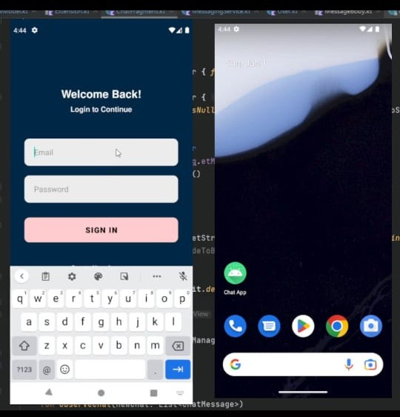
OUTPUT :

Slide 12
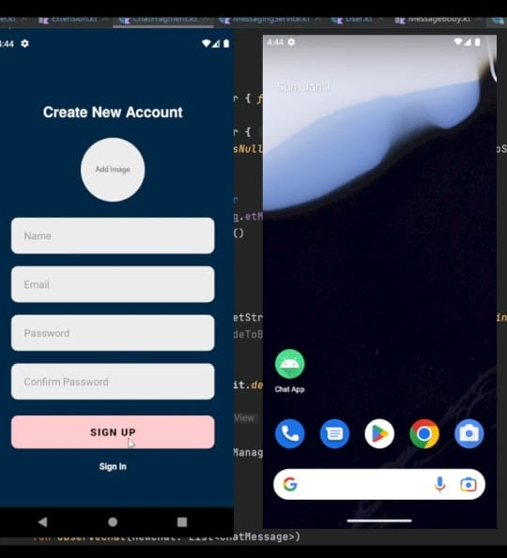

Slide 13
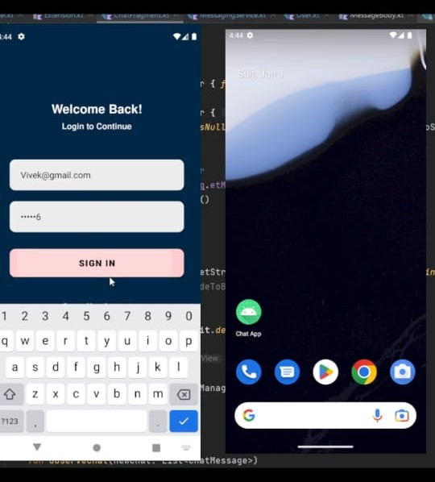

Slide 14
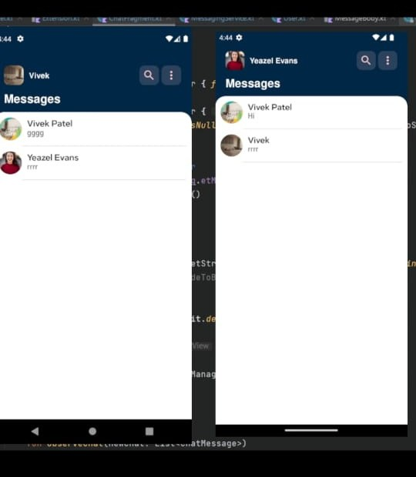

Slide 15
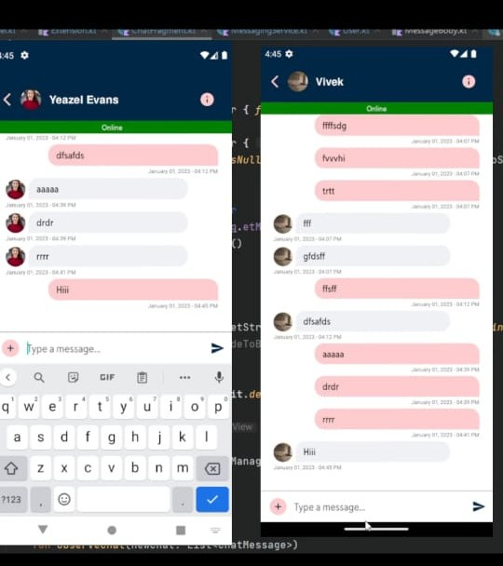

Slide 16
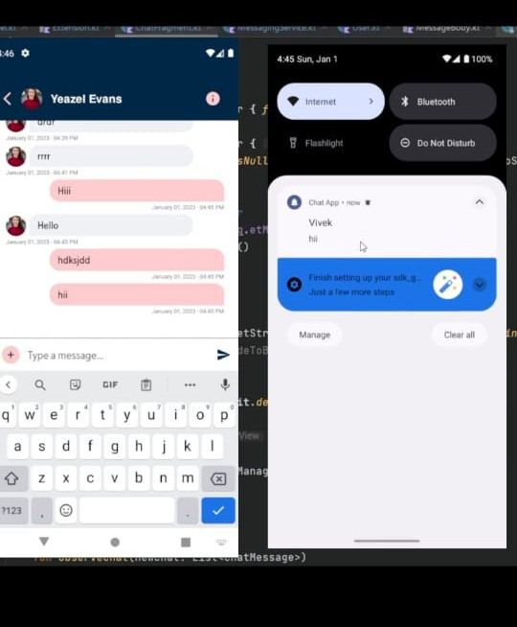

Slide 17
